Slide 1

AI 芯片
— GPU 详解
GPU AI 编程本质
ZOMI

Slide 2
Talk Overview
AI 计算体系
深度学习计算模式
计算体系与矩阵运算
AI 芯片基础
通用处理器 CPU
从数据看 CPU 计算
通用图形处理器 GPU
AI专用处理器 NPU/TPU
计算体系架构的黄金10年
硬件基础
GPU 工作原理
GPU AI编程本质
英伟达 GPU 架构
从 Fermi 到 Hopper 架构
Tensor Code 和 NVLink 详解
GPU 图形处理流水线
图形流水线基础
GPU 逻辑模块划分
图形处理算法到硬件

Slide 3
Talk Overview
硬件基础
GPU 工作原理
GPU AI编程本质
英伟达 GPU 架构
GPU基础概念
从 Fermi 到 Volta 架构
Turing 到 Hopper 架构
Tensor Code 和 NVLink 详解
GPU 图形处理
GPU 逻辑模块划分
算法到 GPU 硬件
GPU 的软件栈
图形流水线基础
流水线不可编译单元
光线跟踪流水线

Slide 4
Talk Overview
GPU AI编程本质
Training and Inference – AI 计算模式与线程的关系
What is inference system – 卷积计算 DEMO
Optimization objectives and constraints – 矩阵乘的算力利用率

Slide 5
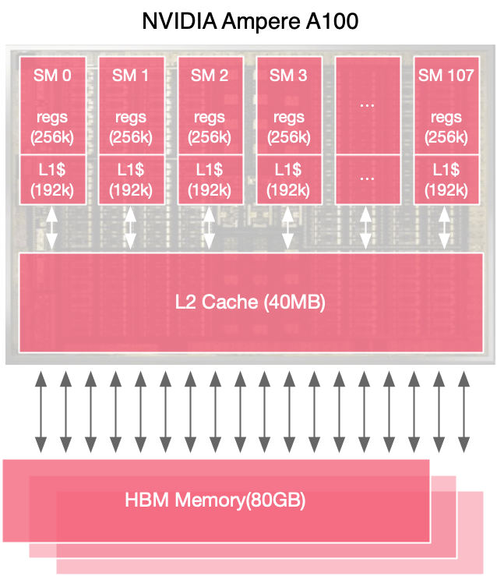
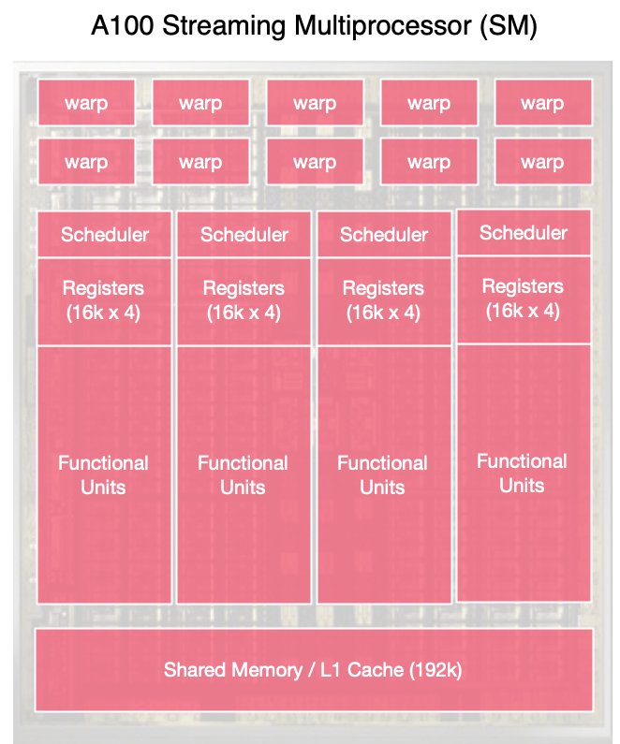
GPU 线程机制
64 warps/SM
4x concurrent warp exec
64k 4-byte registers
192KB L1/shared memory
(configurable split)
GPU runs threads in groups of 32 – each group is known as a warp

Slide 6
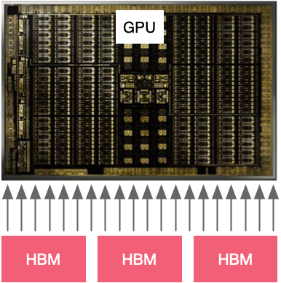
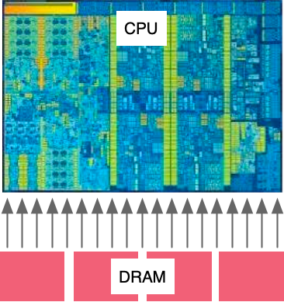
CPU/GPU 并行才是本质
Time

Slide 7
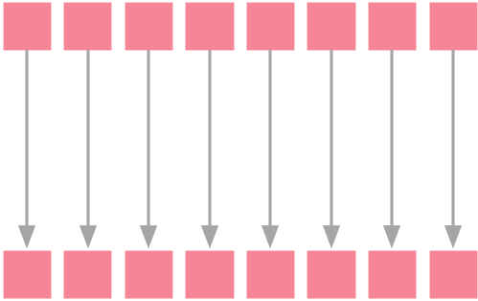
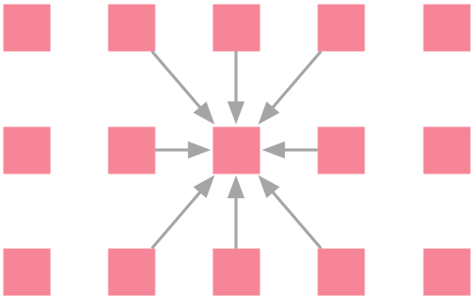
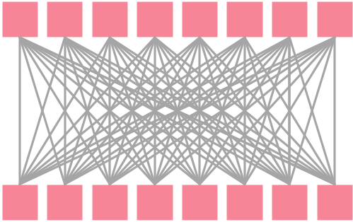
AI 计算模式与线程的关系
在AI计算模式中，不是所有计算都是线程独立的哦
Element-wise
AX+Y
Local
Convolution
All to All
MatMul

Slide 8
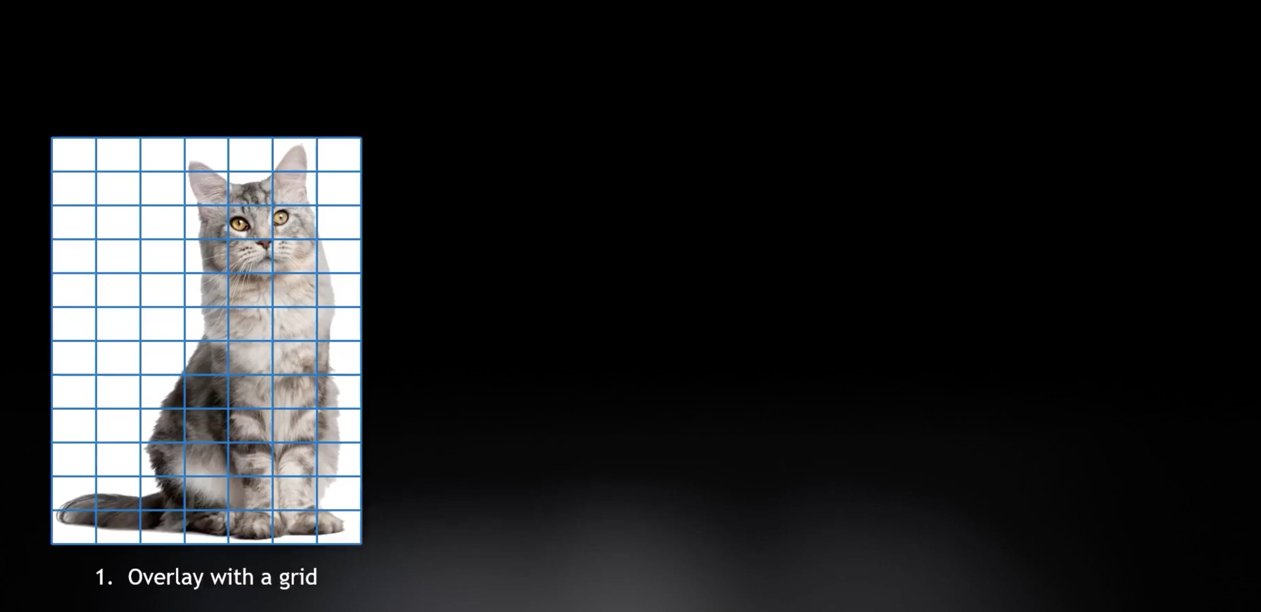
卷积计算 DEMO

Slide 9
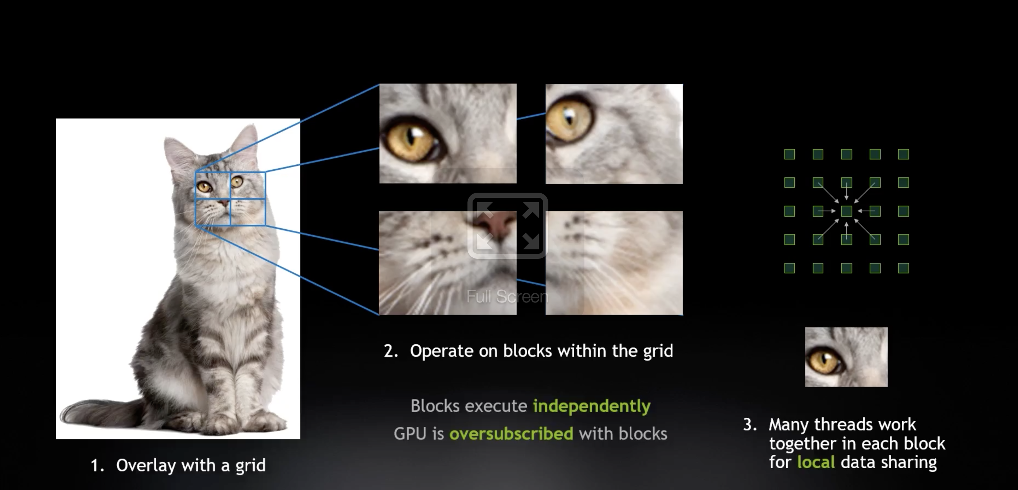
卷积计算 DEMO

Slide 10
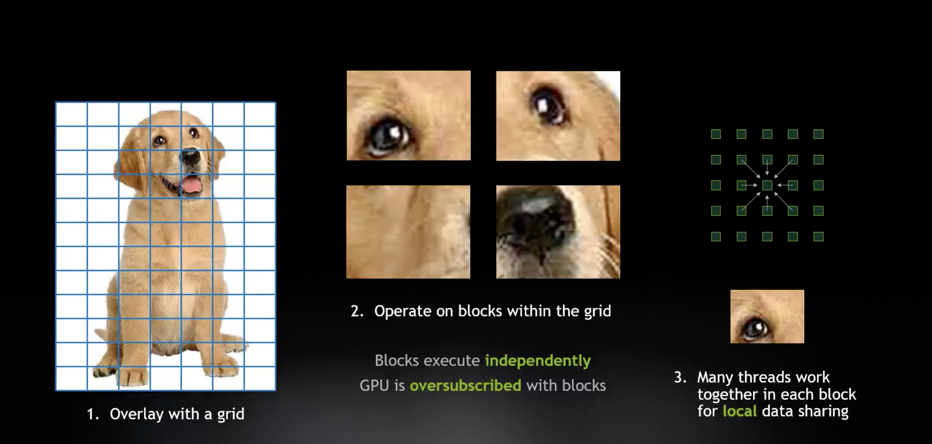
卷积计算 DEMO

Slide 11
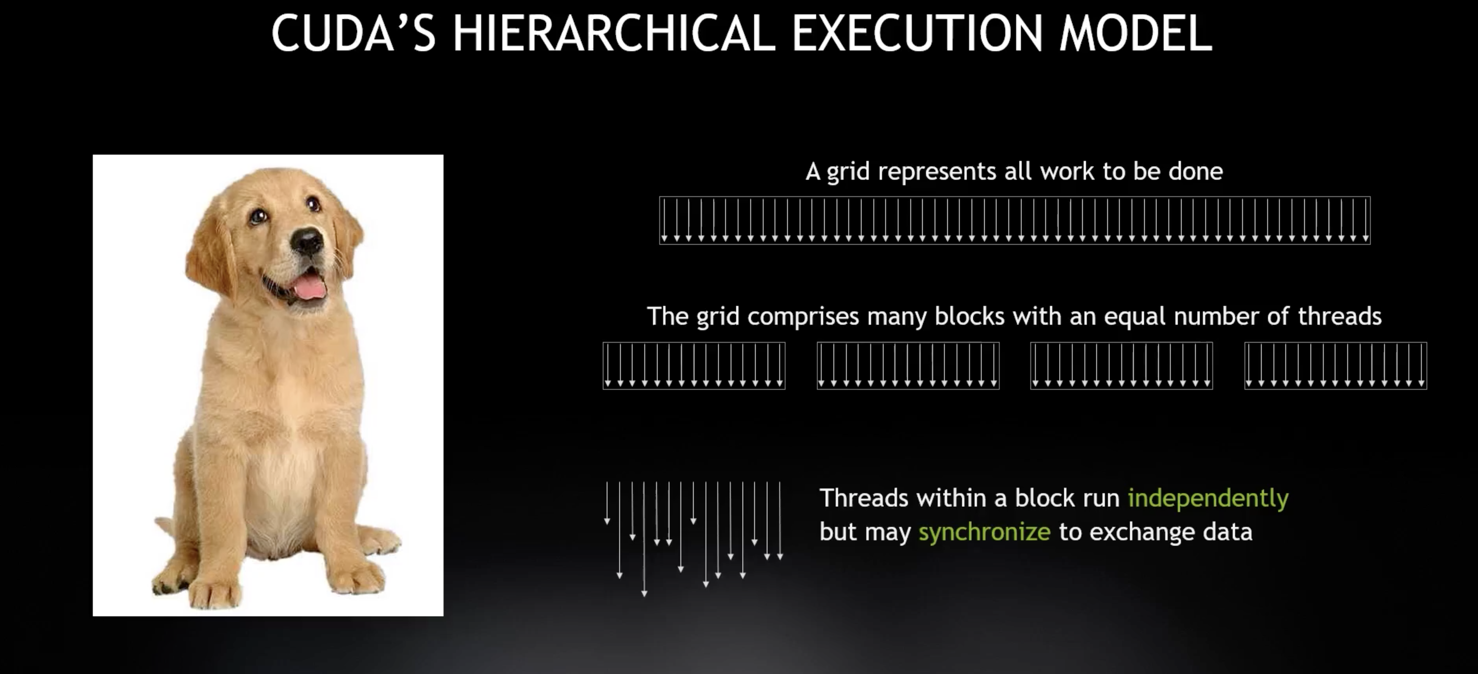
分层的线程执行

Slide 12

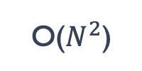






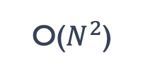
并行提升整体计算强度
Data
Scales
Compute
Scales
Intensity
Scales
Element-wise
O($N$)
O($N$)
O($1$)
Arithmetic
Intensity
Increasing N
Local
O($N^{2}$)
O($N^{2}$)
O($1$)
Arithmetic
Intensity
Increasing N
All to All
O($N$)
O($N^{2}$)
O($N$)
Arithmetic
Intensity
Increasing N

Slide 13

矩阵乘 MM 计算

Slide 14
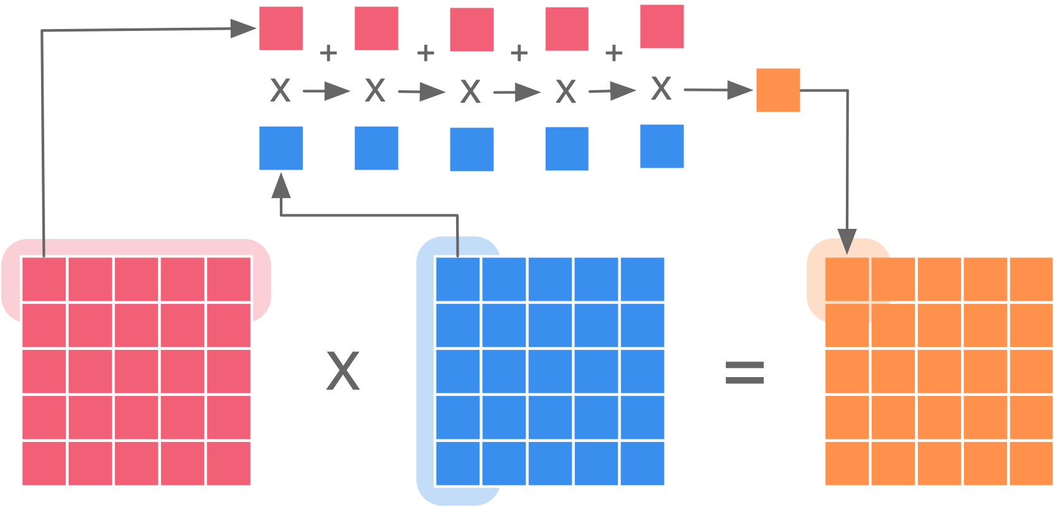
矩阵乘 MM 计算

Slide 15
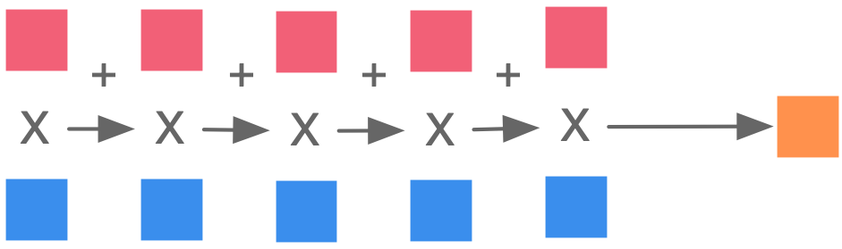
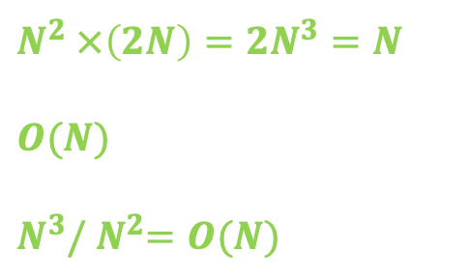
计算强度与矩阵乘的关系
For an NxN matrix:
N row elements multiply with N column elements
N additions create the final result
This is done N^2 times, once for each result element
Arithmetic complexity is therefore:
Number of data loads:
Arithmetic intensity scales as:
$$N^{2} ×\left(2N\right)=2N^{3}=N$$
$$O(N)$$
$$N^{3}/{ N}^{2}=O(N)$$

Slide 16
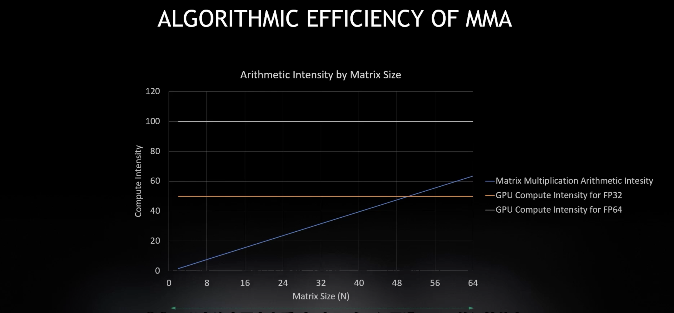
矩阵乘 MM 计算利用率

Slide 17
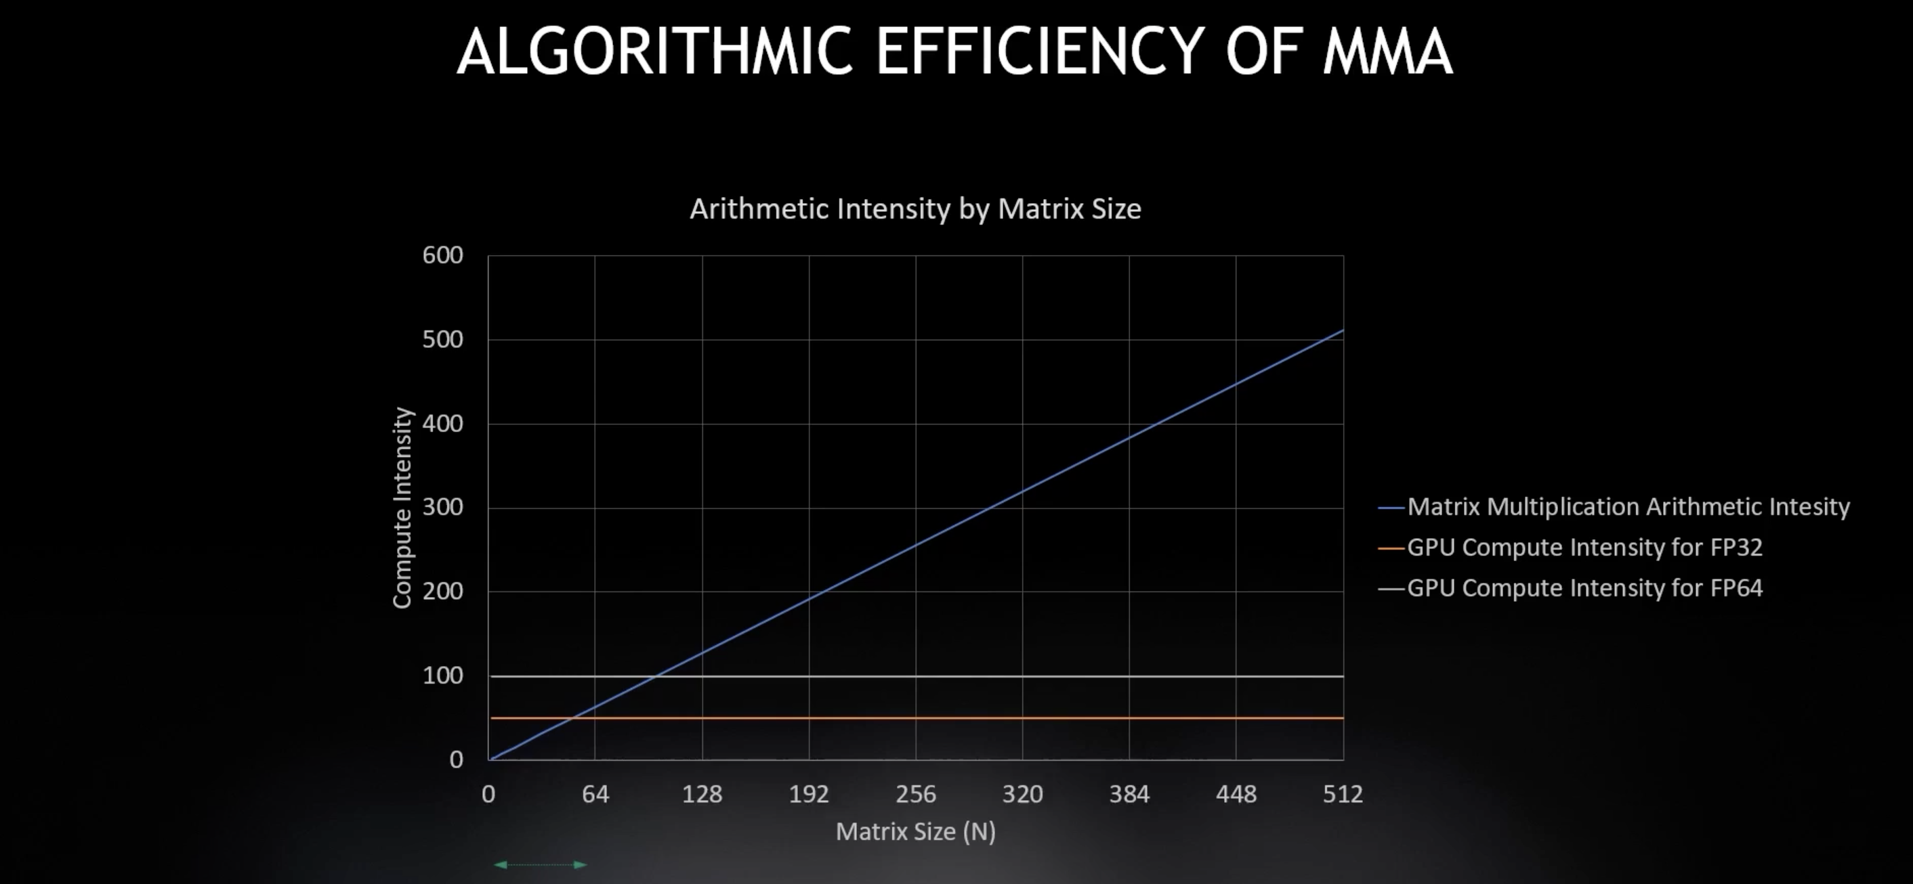
矩阵乘 MM 计算利用率

Slide 18
小矩阵计算
B/W
Latency
Data Location | Bandwidth (GB/sec) | Compute Intensity | Tensor Core
L1 / Shared | 19,400 | 8 | 32
L2 Cache | 4,000 | 39 | 156
HBM | 1,555 | 100 | 401
NVLink | 300 | 520 | 2,080
PCIe | 25 | 6,240 | 24,960
13x
1x
3x
5x
1x
15x

Slide 19
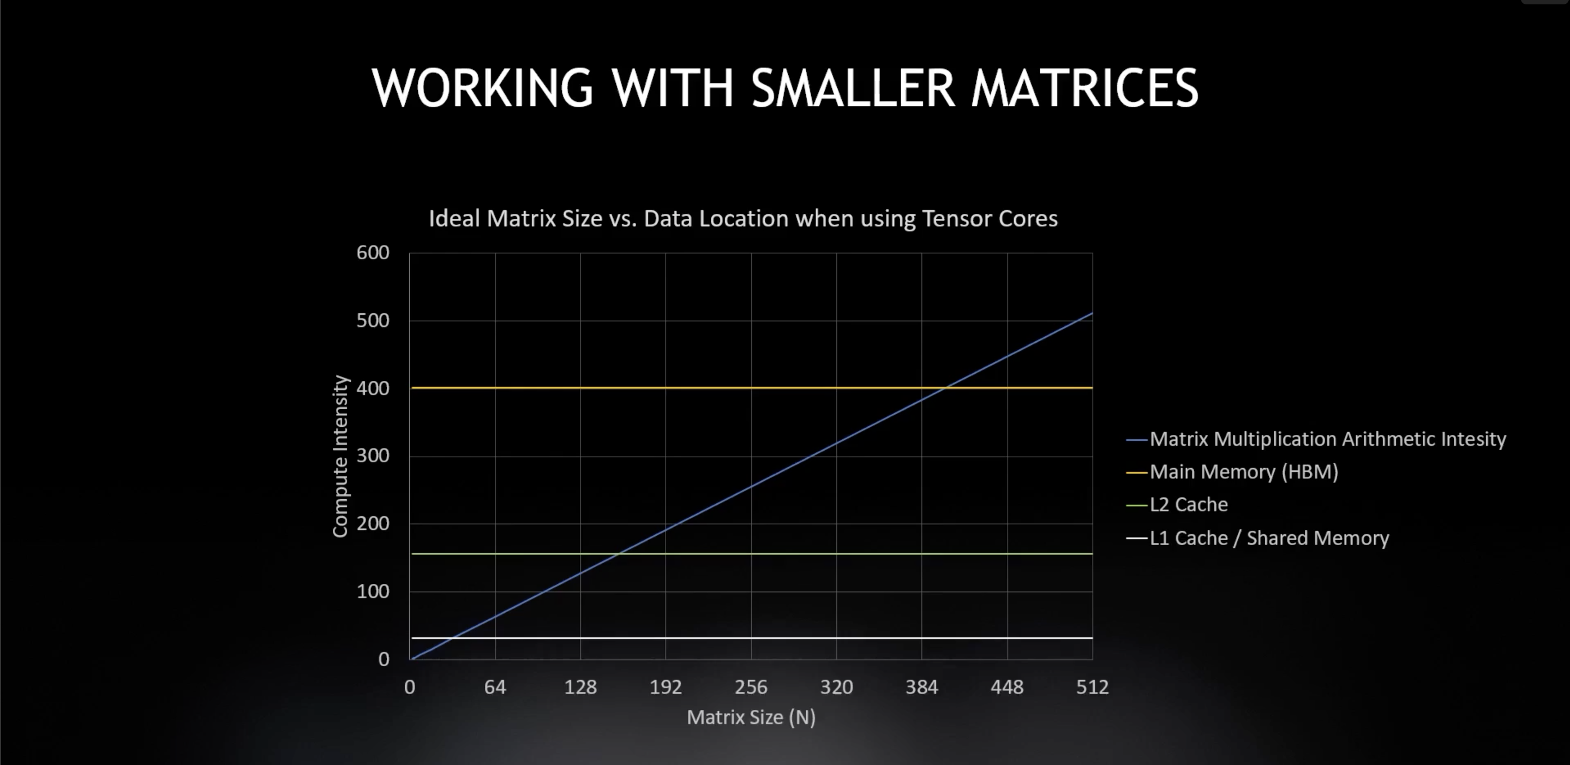
小矩阵计算

Slide 20
Reference
https://www.techtarget.com/searchvirtualdesktop/definition/GPU-graphics-processing-unit
https://www.techtarget.com/searchvirtualdesktop/definition/GPU-graphics-processing-unit#:~:text=GPUs%20work%20by%20using%20a,%2C%20high%2Dquality%20graphics%20rendering.
https://computer.howstuffworks.com/graphics-card.htm
https://www.cs.cmu.edu/afs/cs/academic/class/15462-f11/www/lec_slides/lec19.pdf
https://www.intel.com/content/www/us/en/products/docs/processors/what-is-a-gpu.html
https://www.investopedia.com/terms/g/graphics-processing-unit-gpu.asp
https://www.youtube.com/watch?v=0_TN845dxUU
https://www.youtube.com/watch?v=nEMzIwzmJT8
https://www.heavy.ai/technical-glossary/cpu-vs-gpu
https://www.youtube.com/watch?v=3l10o0DYJXg
https://www.youtube.com/watch?v=658n_Ym8dkk
https://www.youtube.com/watch?v=5BiAlaFGCoE
https://www.youtube.com/watch?v=bZdxcHEM-uc

Slide 21
Notes:
21

